Slide 1
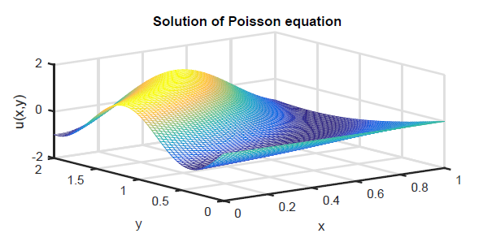
Chapter 13 Two-dimensional Problems

Slide 2
Two dimensional problems
We’ve seen ODEs that have either space or time as independent variables
IVPs: time
BVPs: space
We’ve seen PDEs that have space and time as independent variables
Heat equation (parabolic)
Advection and wave equations, e.g. (hyperbolic)
Now we turn to two independent variables that are both in space: Elliptic PDE
These are like BVPs for an equilibrium function

Slide 3
Section 13.1 Tensor-product discretizations

Slide 4
Tensor-product discretizations
First we need grids in two dimensions.
Then we define functions on 2D grids
Then we approximate partial derivatives on the grids
At that point, we are able to replace PDE problems with algebra that we can solve with methods from earlier in the text

Slide 5
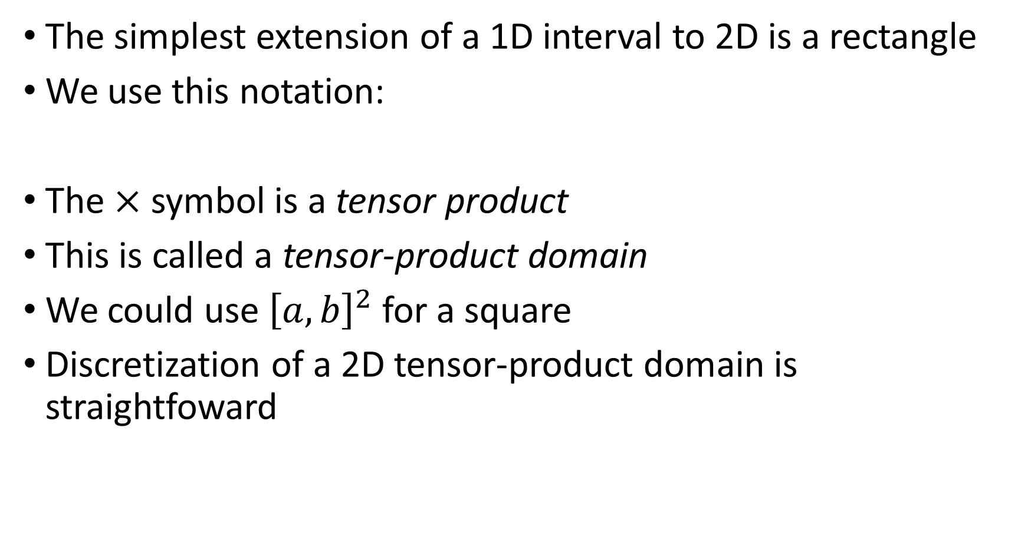
Tensor-product discretizations
The simplest extension of a 1D interval to 2D is a rectangle
We use this notation:
The $×$ symbol is a tensor product
This is called a tensor-product domain
We could use ${\left[a,b\right]}^{2}$for a square
Discretization of a 2D tensor-product domain is straightfoward

Slide 6
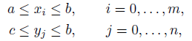
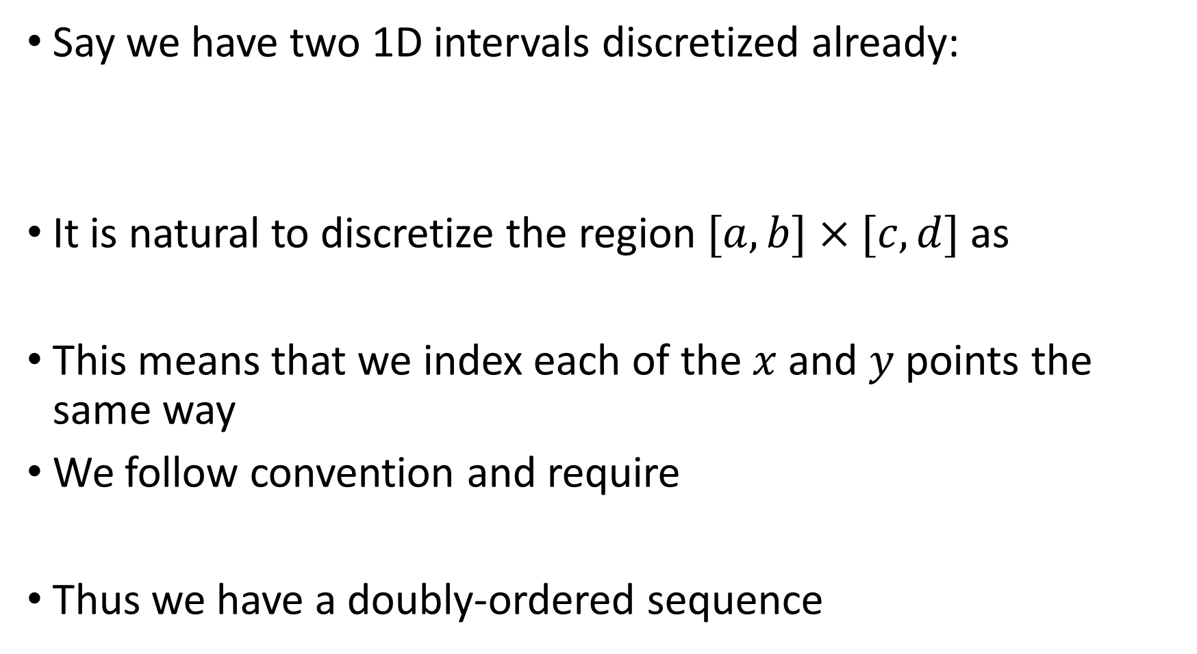
Tensor-product discretizations
Say we have two 1D intervals discretized already:
It is natural to discretize the region $[a,b]×[c,d]$as
This means that we index each of the $x$ and $y$ points the same way
We follow convention and require
Thus we have a doubly-ordered sequence

Slide 7
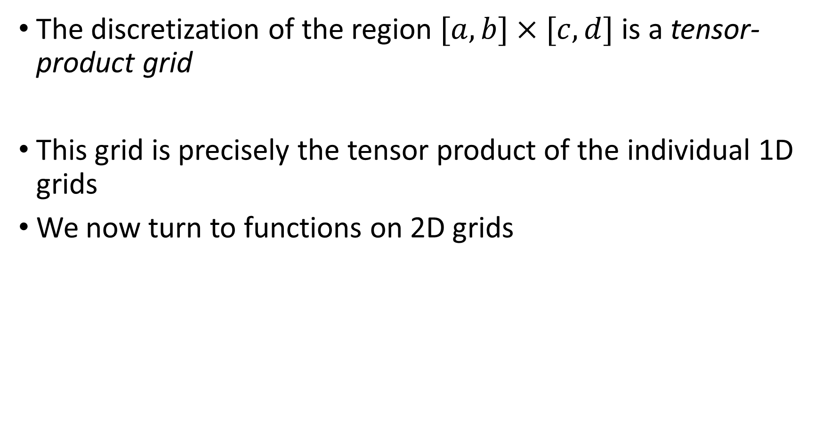
Tensor-product discretizations
The discretization of the region $[a,b]×[c,d]$ is a tensor-product grid
This grid is precisely the tensor product of the individual 1D grids
We now turn to functions on 2D grids

Slide 8
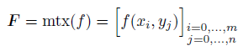
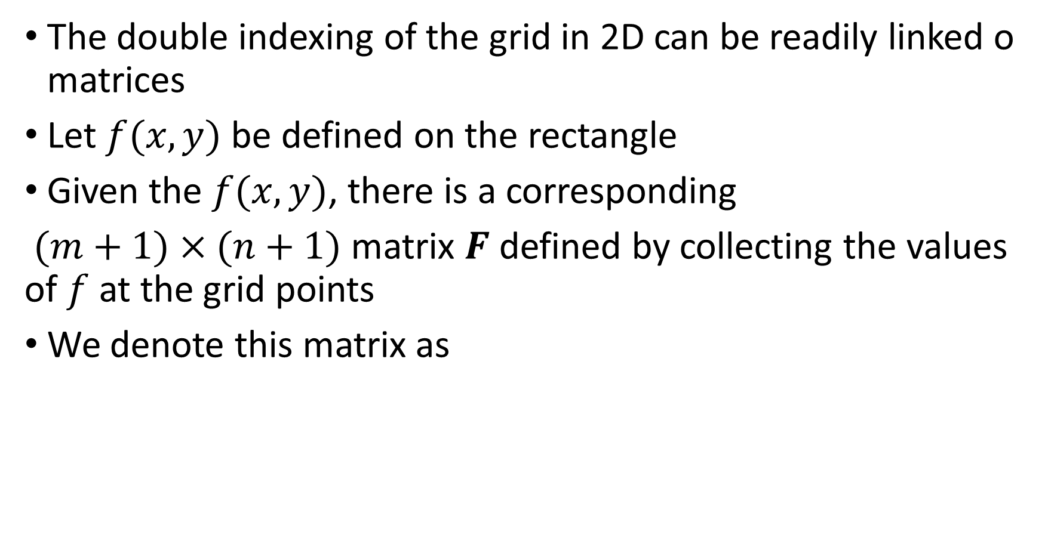
Functions on grids
The double indexing of the grid in 2D can be readily linked o matrices
Let $f(x,y)$ be defined on the rectangle
Given the $f(x,y)$, there is a corresponding
$(m+1)×(n+1)$matrix $F$ defined by collecting the values of $f$ at the grid points
We denote this matrix as

Slide 9
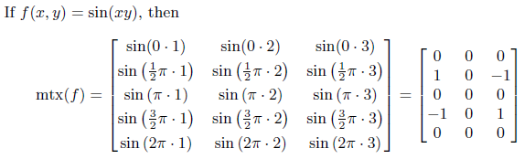
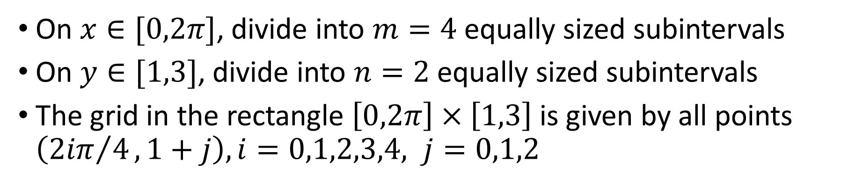
Example: function on 2D grid
On $x∈[0,2π]$, divide into $m=4$ equally sized subintervals
On $y∈[1,3]$, divide into $n=2$ equally sized subintervals
The grid in the rectangle $\left[0,2π\right]×\left[1,3\right]$ is given by all points $\left({2iπ}/4,1+j\right), i=0,1,2,3,4, j=0,1,2$

Slide 10
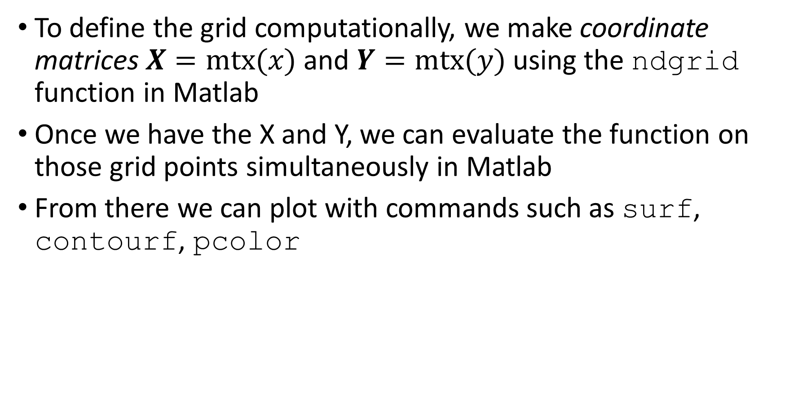
Functions on grids
To define the grid computationally, we make coordinate matrices $X=mtx(x)$ and $Y=mtx(y)$ using the ndgrid function in Matlab
Once we have the X and Y, we can evaluate the function on those grid points simultaneously in Matlab
From there we can plot with commands such as surf, contourf, pcolor

Slide 11
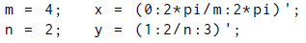
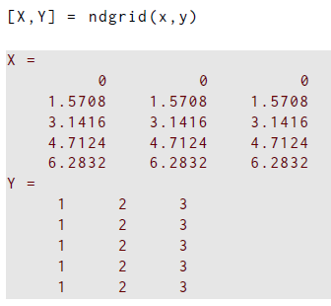
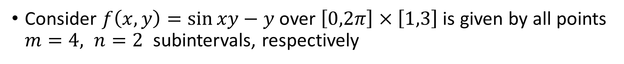
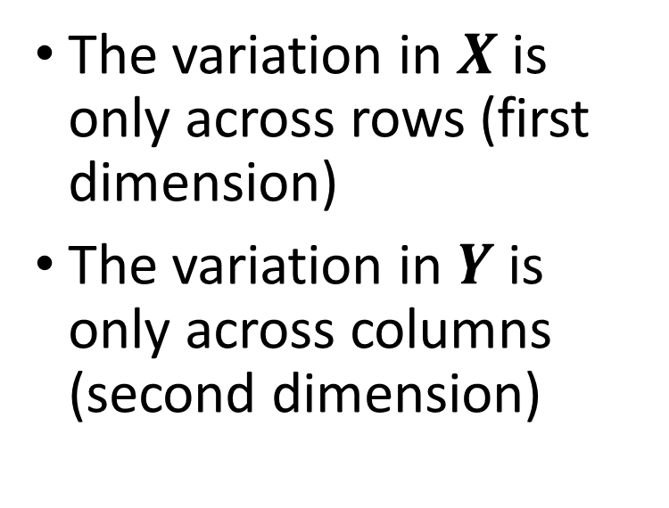
Example: Plotting on a 2D grid
Consider $f\left(x,y\right)=\sin{xy}−y$ over $\left[0,2π\right]×\left[1,3\right]$ is given by all points $m=4, n=2$ subintervals, respectively
The variation in $X$ is only across rows (first dimension)
The variation in $Y$ is only across columns (second dimension)

Slide 12
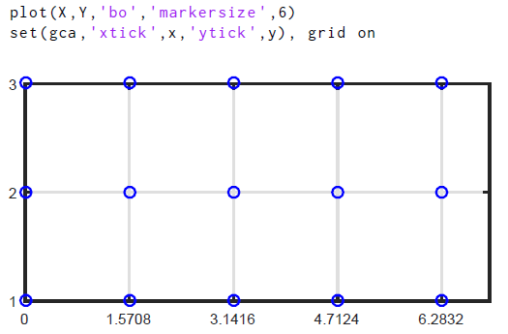
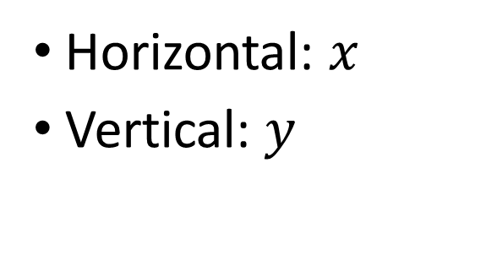
Example: Plotting on a 2D grid
Visualize the grid over $\left[0,2π\right]×\left[1,3\right]$
Horizontal: $x$
Vertical: $y$

Slide 13
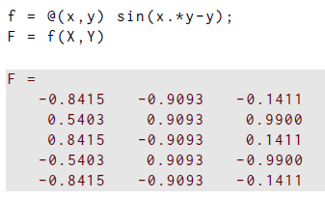
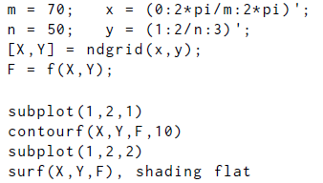
Example: Plotting on a 2D grid
Now generate the function on this course grid
To make a nice plot, we want a much finer grid

Slide 14
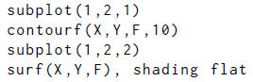
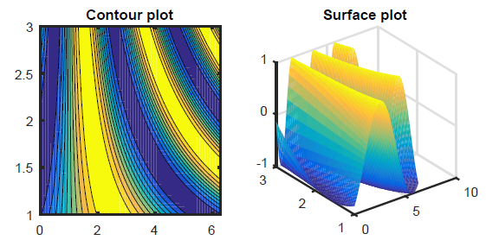
Example: Plotting on a 2D grid
Visualize the function $F=mtx(f)$ over $\left[0,2π\right]×\left[1,3\right]$

Slide 15
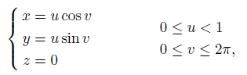
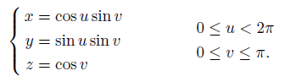
Parametrized surfaces
We don’t have to limit ourselves to rectangles to get the benefit of tensor product grids
Regions that are “logically rectangular” can be the unit disk and the surface of the unit spheres
Unit disk:
Surface of unit sphere:

Slide 16
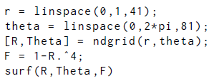
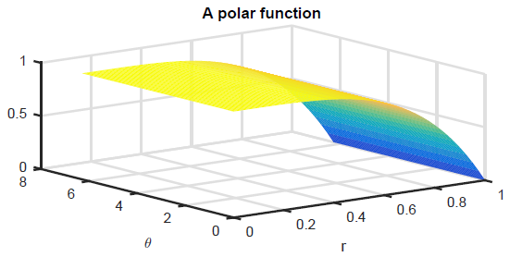
Example: Plotting on a 2D grid
Plot in polar coordinates $(r,θ)$for $f(r,θ)=1−r^{4}$, grid over $[0,1]×\left[0,2π\right]$
Not very helpful plot
Should really put into usual form

Slide 17
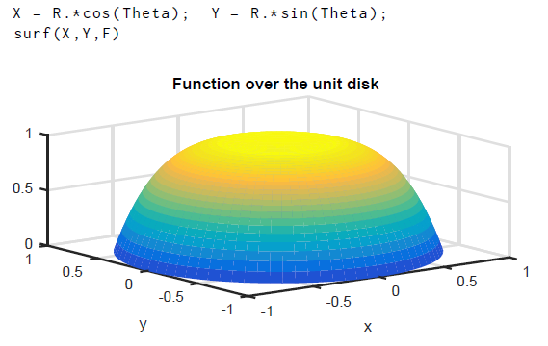
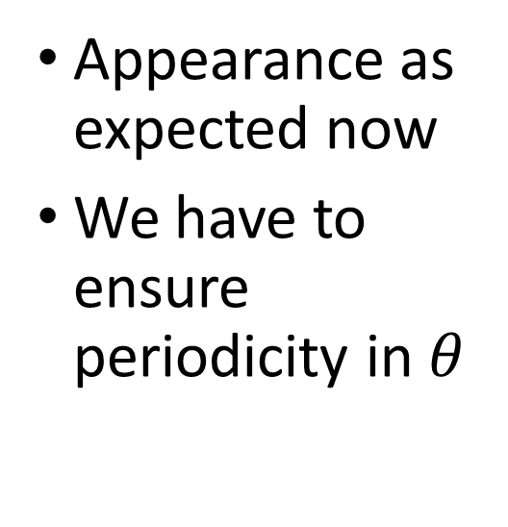
Example: Plotting on a 2D grid
Plot in polar coordinates $(r,θ)$for $f(r,θ)=1−r^{4}$, grid over $[0,1]×\left[0,2π\right]$
Appearance as expected now
We have to ensure periodicity in $θ$

Slide 18
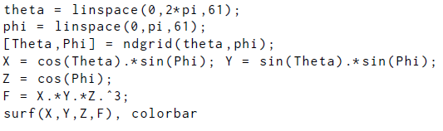
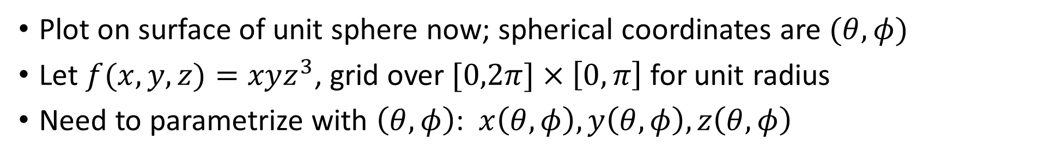
Example: Plotting on a 2D grid
Plot on surface of unit sphere now; spherical coordinates are $(θ,φ)$
Let $f(x,y,z)=xyz^{3}$, grid over $[0,2π]×\left[0,π\right]$ for unit radius
Need to parametrize with $\left(θ,φ\right)$: $x\left(θ,φ\right),y\left(θ,φ\right),z\left(θ,φ\right)$

Slide 19
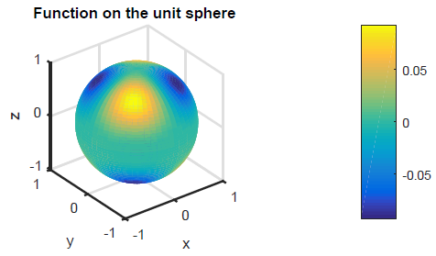
Example: Plotting on a 2D grid
Plot on surface of unit sphere now; $f(x,y,z)=xyz^{3}$

Slide 20
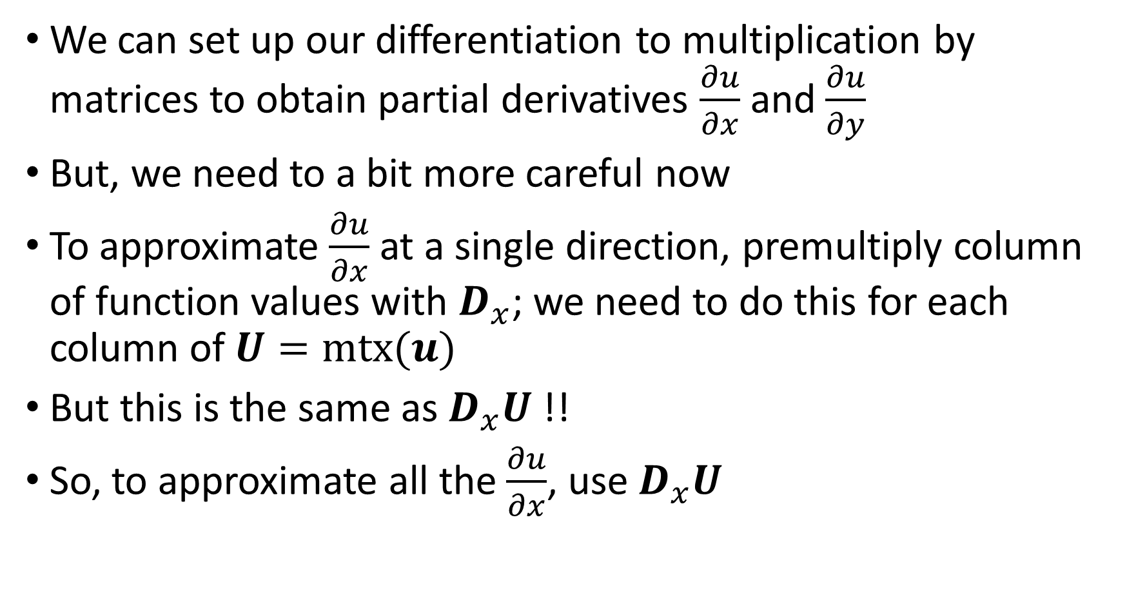
Partial derivatives
We can set up our differentiation to multiplication by matrices to obtain partial derivatives $\frac{∂u}{∂x}$ and $\frac{∂u}{∂y}$
But, we need to a bit more careful now
To approximate $\frac{∂u}{∂x}$ at a single direction, premultiply column of function values with $D_{x}$; we need to do this for each column of $U=mtx(u)$
But this is the same as $D_{x}U$ !!
So, to approximate all the $\frac{∂u}{∂x}$, use $D_{x}U$

Slide 21
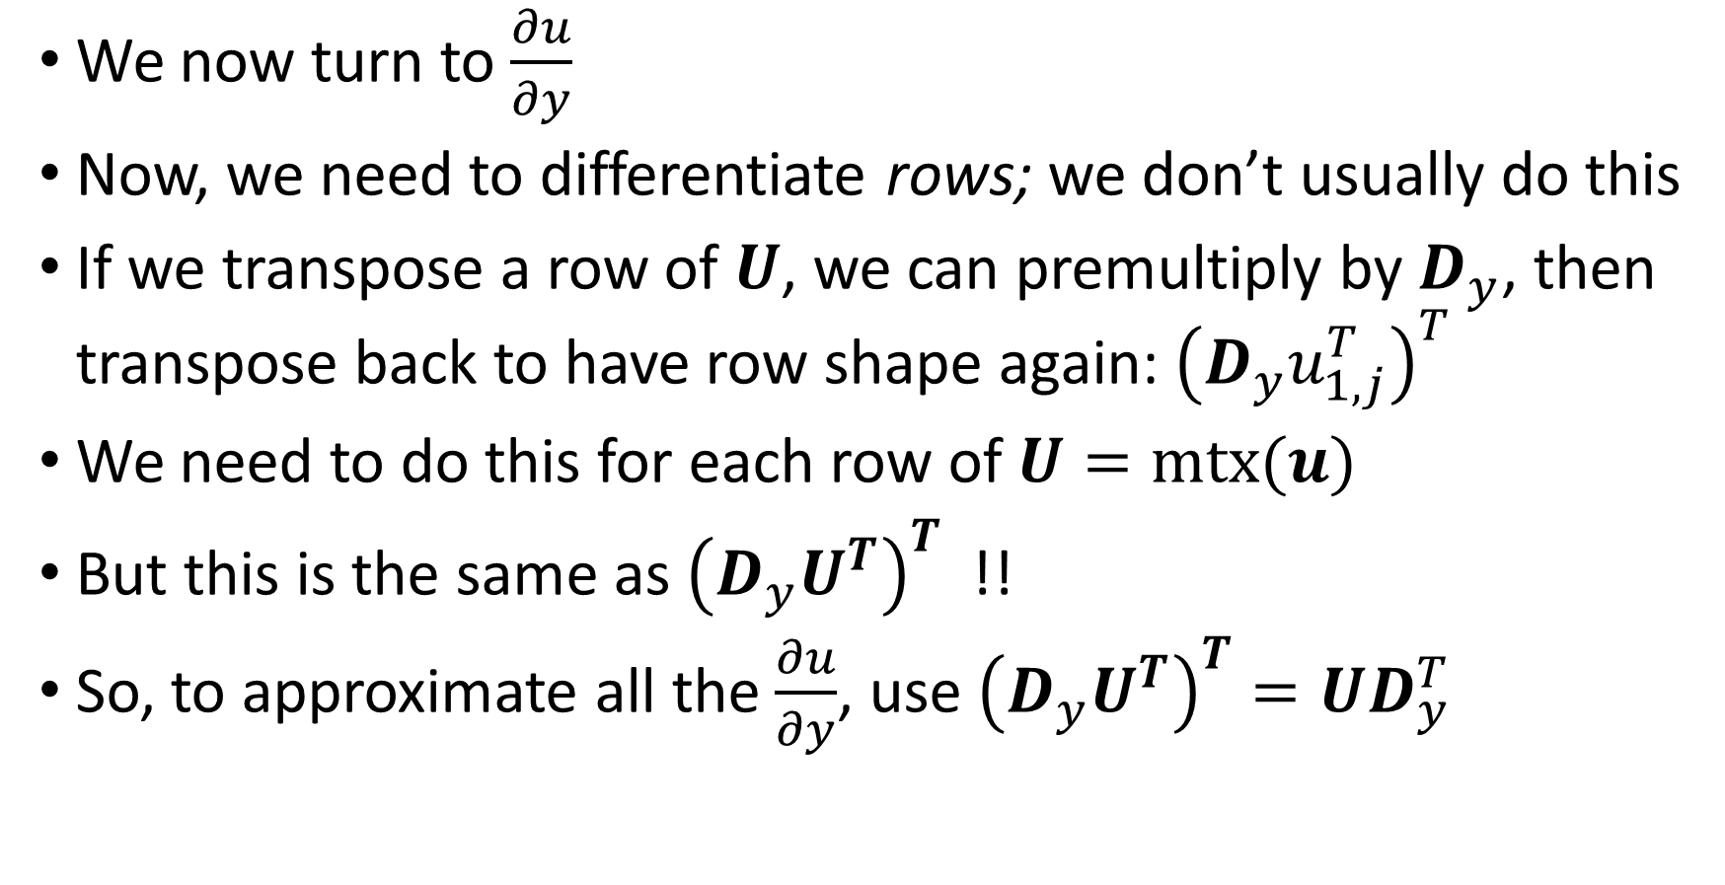
Partial derivatives
We now turn to $\frac{∂u}{∂y}$
Now, we need to differentiate rows; we don’t usually do this
If we transpose a row of $U$, we can premultiply by $D_{y}$, then transpose back to have row shape again: ${\left(D_{y}u_{1,j}^{T}\right)}^{T}$
We need to do this for each row of $U=mtx(u)$
But this is the same as ${\left(D_{y}U^{T}\right)}^{T}$ !!
So, to approximate all the $\frac{∂u}{∂y}$, use ${\left(D_{y}U^{T}\right)}^{T}={UD}_{y}^{T}$

Slide 22
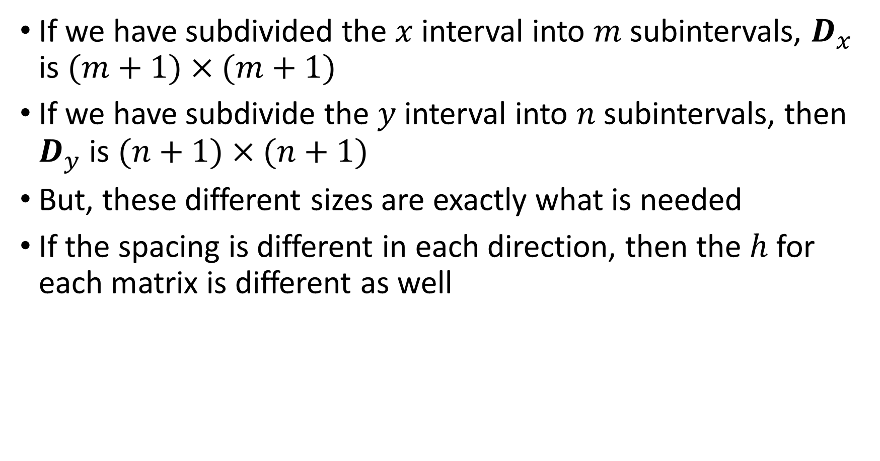
Partial derivatives: details to keep in mind
If we have subdivided the $x$ interval into $m$ subintervals, $D_{x}$ is $(m+1)×(m+1)$
If we have subdivide the $y$ interval into $n$ subintervals, then $D_{y}$ is $(n+1)×(n+1)$
But, these different sizes are exactly what is needed
If the spacing is different in each direction, then the $h$ for each matrix is different as well

Slide 23
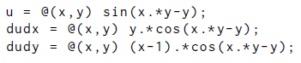
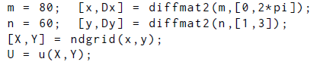
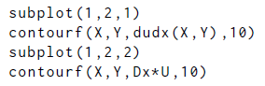
Example: Partial derivatives, 2D
Compute partial derivatives of $f(x,y)=sin⁡(xy−y)$ and plot them
Calculate exact answer
Setup grid and differentiation matrices
Plot results

Slide 24
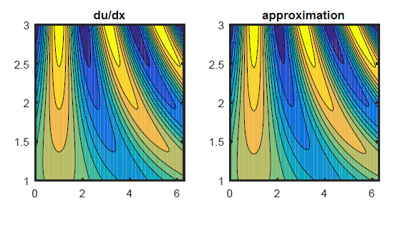
Example: Partial derivatives, 2D
Compute $\frac{∂f}{∂x}$ for $f(x,y)=sin⁡(xy−y)$ and plot
Can’t see error, but not too good at this level of discretization

Slide 25
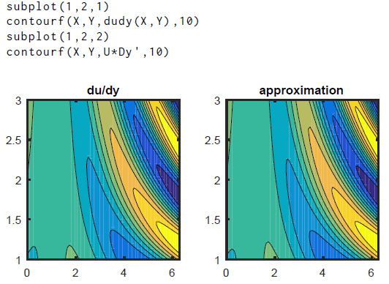
Example: Partial derivatives, 2D
Compute $\frac{∂f}{∂y}$ for $f(x,y)=sin⁡(xy−y)$ and plot
Can’t see error, but not too good at this level of discretization

Slide 26
Section 13.2 2D diffusion and advection

Slide 27
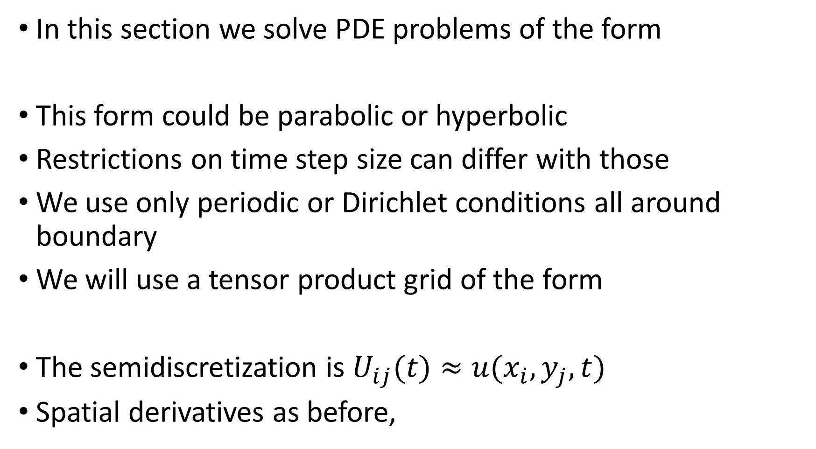
2D advection-diffusion problems
In this section we solve PDE problems of the form
This form could be parabolic or hyperbolic
Restrictions on time step size can differ with those
We use only periodic or Dirichlet conditions all around boundary
We will use a tensor product grid of the form
The semidiscretization is $U_{ij}(t)≈u(x_{i},y_{j},t)$
Spatial derivatives as before,

Slide 28
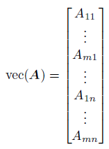
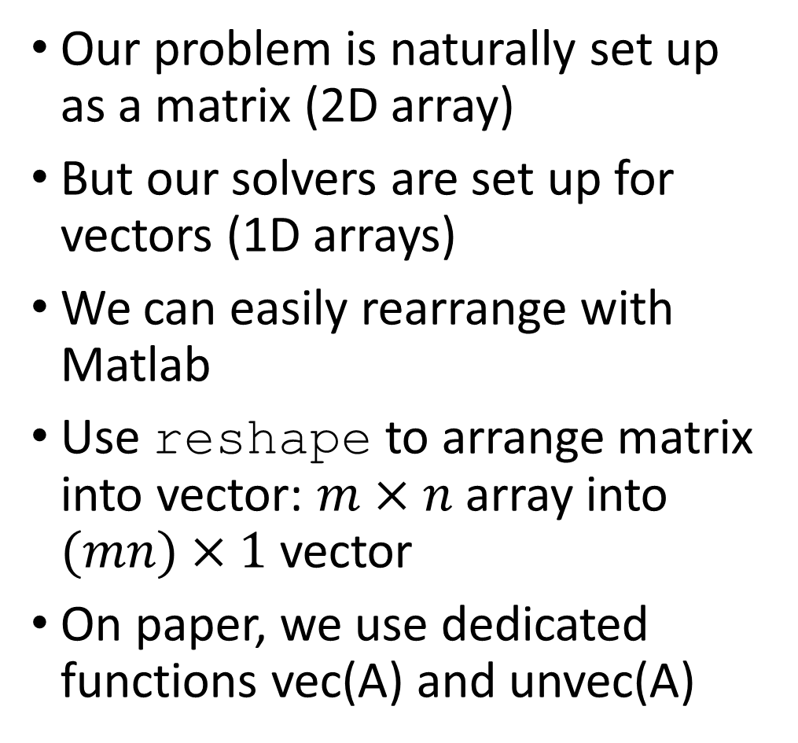
Matrix and vector shapes
Our problem is naturally set up as a matrix (2D array)
But our solvers are set up for vectors (1D arrays)
We can easily rearrange with Matlab
Use reshape to arrange matrix into vector: $m×n$ array into $(mn)×1$vector
On paper, we use dedicated functions vec(A) and unvec(A)
}
First column
here
}
nth column
here

Slide 29
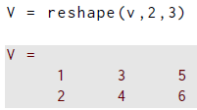
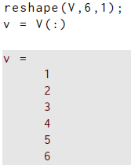
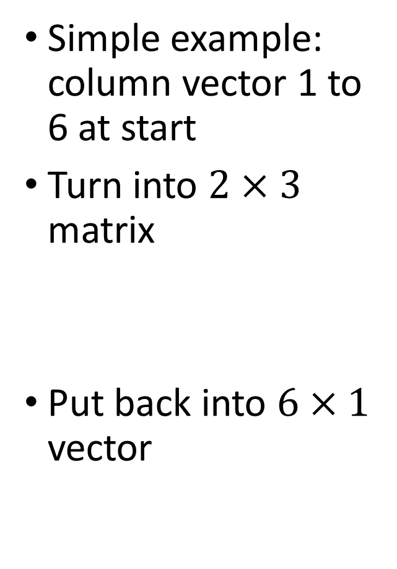
Example: reshaping
Simple example: column vector 1 to 6 at start
Turn into $2×3$ matrix
Put back into $6×1$ vector

Slide 30
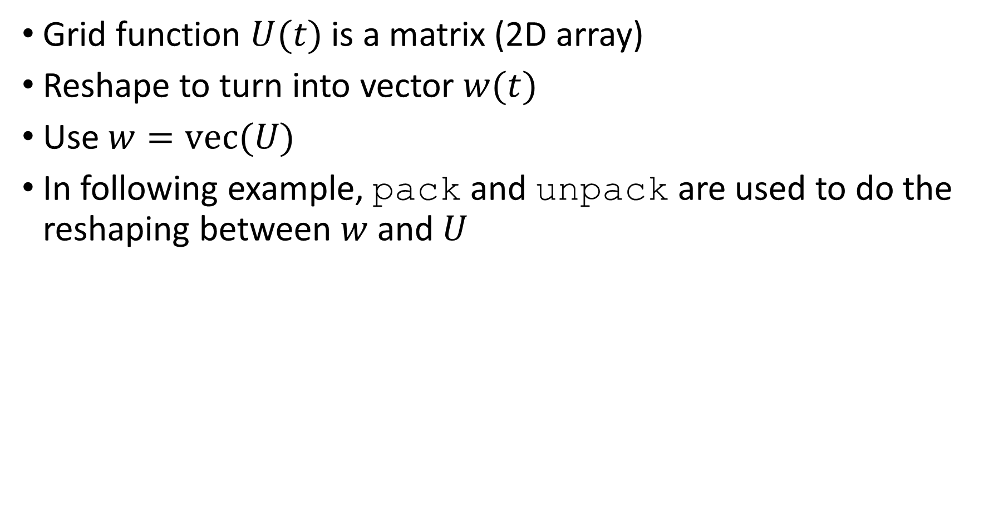
Grid functions and reshaping
Grid function $U(t)$ is a matrix (2D array)
Reshape to turn into vector $w(t)$
Use $w=vec(U)$
In following example, pack and unpack are used to do the reshaping between $w$ and $U$

Slide 31
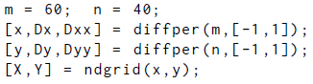
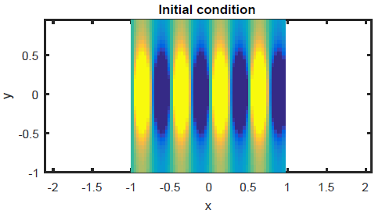
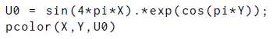
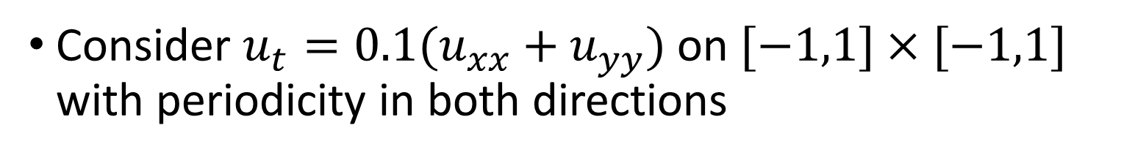
Example: reshaping
Consider $u_{t}=0.1(u_{xx}+u_{yy})$ on $[−1,1]×[−1,1]$ with periodicity in both directions

Slide 32
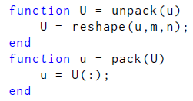
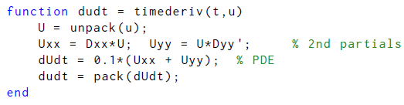

Example: reshaping
Packing and unpacking functions, then derivatives, then solve

Slide 33


Example: reshaping
Plot results at two times; smoothing apparent

Slide 34
Boundary conditions
We proceed with boundary conditions similarly to section 11.5 for diffusion equations
We will add the BC values onto the interior unknowns (extend->unpack) and then remove them for the solver for the interior points (chop->pack)
This is done in the function 13.2.1 (rectdisc.m)
A structure holds the differentiation matrices, and an indicator array that marks the boundary points
After calling this function, we solve the IVP for the interior points

Slide 35


Slide 36


Example: advection-diffusion prob
$u_{t}+u_{x}=1+0.05(u_{xx}+u_{yy})$on $\left[−1,1\right]×\left[−1,1\right]$, $u=0$ on boundaries

Slide 37




Example: advection-diffusion prob
$u_{t}+u_{x}=1+0.05(u_{xx}+u_{yy})$on $\left[−1,1\right]×\left[−1,1\right]$, $u=0$ on boundaries
Pack to add boundary values
Unpack to strip boundary values
Set up rhs function for solving for interior unknowns
Stiff system

Slide 38


Example: advection-diffusion prob
$u_{t}+u_{x}=1+0.05(u_{xx}+u_{yy})$on $\left[−1,1\right]×\left[−1,1\right]$, $u=0$ on boundaries
Plot result
Unpack W to plot with BC values
Small diffusion allows $u$ to pile up at right side

Slide 39


Boundary conditions for wave equation
We now consider $u_{tt}=u_{xx}+u_{yy}$ on ${\left[−2,2\right]}^{2}$, $u=0$ BCs
Our approach in 1D was to write as a first order system
Here we write
Semidiscretization gives two grid functions $U(t)$ and $V(t)$
We need to reshape them, and append them into a single vector of unknowns $w(t)$ for the solver
Boundary values are applied on $U$ but not $V$

Slide 40



Example: wave equation with BCs
$u_{tt}=u_{xx}+u_{yy}$on $\left[−2,2\right]×\left[−2,2\right]$, $u=0$ on boundaries
Set up discretization with rectdisc
Plot $U(0)$; $V(0)=0$

Slide 41




Example: wave equation with BCs
$u_{tt}=u_{xx}+u_{yy}$on $\left[−2,2\right]×\left[−2,2\right]$, $u=0$ on boundaries
Unpack adds BC values to $U$ and separates $U$ and $V$
Pack removes BC values from $U$ and combines $U$ and $V$
Set up rhs for IVP solver

Slide 42


Example: wave equation with BCs
$u_{tt}=u_{xx}+u_{yy}$on $\left[−2,2\right]×\left[−2,2\right]$, $u=0$ on boundaries
Hyperbolic problem: nonstiff solver is fine
Plot answers

Slide 43

Example: wave equation with BCs
$u_{tt}=u_{xx}+u_{yy}$on $\left[−2,2\right]×\left[−2,2\right]$, $u=0$ on boundaries
Circular propagation outward from center
What happens when wave reaches boundary?

Slide 44

Example: wave equation with BCs
$u_{tt}=u_{xx}+u_{yy}$on $\left[−2,2\right]×\left[−2,2\right]$, $u=0$ on boundaries
Reflections from boundaries!
Leading edge flips to blue

Slide 45
Section 13.3 Laplace and Poisson equations

Slide 46

Laplace and Poisson equations
Consider the heat equation in 2D
$$u_{t}=u_{xx}+u_{yy}−f\left(x,y\right), in \left[a,b\right]×[c,d]$$
If we let $t→∞$, then u will not depend on time anymore, and the steady state version will be obtained: say $v(x,y)$
The steady state satisfies
$$v_{xx}+v_{yy}=f\left(x,y\right)$$
This is called a Poisson equation
If $f=0$, then it is a Laplace equation
The Laplace or Poisson equations are linear and second order: the type is elliptic

Slide 47

Laplace and Poisson equations
So, we want to solve for $u(x,y)$:
$$u_{xx}+u_{yy}=f\left(x,y\right), (x,y)∈\left[a,b\right]×[c,d]$$
On the boundary, we consider only Dirichlet conditions:
$$u\left(x,y\right)=g(x,y)$$
The boundary function $g(x,y)$ is given (known)
There is a boundary value given at both sides in $x$: this is exactly what is need from $u_{xx}$
Two boundary values in $y$ as well, perfect for $u_{yy}$
This is the prototypical BVP in two dimensions: $Δu=f$
$Δ$ is the Laplacian operator (coordinate independent)

Slide 48


Discretizing the Poisson equation
Stick with Cartesian coordinates
$$u_{xx}+u_{yy}=f\left(x,y\right), (x,y)∈\left[a,b\right]×[c,d]$$
We discretize x,y to get the grid
Then want to find approximations to $U=mtx(u)$, that is, $U_{ij}(t)≈u(x_{i},y_{j},t)$
Create $D_{xx}$ and $D_{yy}$ as before
Evaluate the forcing on the grid too: $F=mtx(f)$
The discrete equation is then:

Slide 49
Sylvester equation
The discrete equation is
Look carefully:
the equation is linear for the elements of U
the unknowns are multiplied on both left and right by coefficient matrices
This is called a Sylvester equation
For computing, we need to cast it into a different form
We introduce a new operation for this

Slide 50


Kronecker products
Let $A$ be $m×n$ and $B$ be $p×q$
The Kronecker product $A⨂B$ is the $mp×nq$ matrix defined by
There are no restrictions on the sizes of $A$ and $B$
Let’s do an example

Slide 51



Example: Kronecker products
$2×2$ and $2×3$ matrices: output size depends on order
First, manual evaluation, with $(2)(2)×(2)(3)$ ouptut

Slide 52

Example: Kronecker products
Now use built in kron function

Slide 53



Kronecker products
The Kronecker product has a number of useful identities:
Now $A, B, C$, and $D$ must have appropriate sizes
This one is crucial for our Sylvester equation:

Slide 54



Poisson as a linear system
Now let’s go back and write the discrete equation as
Here the identity matrix $I_{x}$ is $(m+1)×(m+1)$ and $I_{y}$ is $(n+1)×(n+1)$
The identity matrices don’t change the equation but allow us to see how to rewrite it:
This equation fits the form $Au=b$

Slide 55

Poisson as a linear system
In matrix vector form:
This equation fits the form $Au=b$ with
$$A=\left(I_{y}⨂D_{xx}\right)+\left(D_{yy}⨂I_{x}\right)$$
$$u=vec\left(U\right)$$
$$b=vec(F)$$
Let $N=\left(m+1\right)\left(n+1\right)$
$u$ and $b$ are $N×1$
A is $N×N$

Slide 56



Poisson as a linear system
Now we need to incorporate the boundary conditions.
We have unknowns numbered from 1 to N
Reshape the boundary matrix, we know which indices correspond to boundary points: $i∈B$ iff $(x_{i},y_{i})$is on boundary
Replace those rows with
We can write this process in matrix form:
But, rather than form these matrices, we use logical indexing

Slide 57

Poisson as a linear system
Now we need to incorporate the boundary conditions.
We have unknowns numbered from 1 to N
Reshape the boundary matrix, we know which indices correspond to boundary points: $i∈B$ iff $(x_{i},y_{i})$is on boundary
Replace those rows with
We can write this process in matrix form:
$I_{B}$ is $N×N$ identity with all rows set to zero except for $i∈B$
But, rather than form these matrices, we use logical indexing

Slide 58



Example: Poisson eqn solution
Specify rhs function
Simple discretization
rhs function on grid
Create $A$ and spy(A)

Slide 59




Example: Poisson eqn solution
Rhs is vec(F)
$N=42$ here
Show boundary points

Slide 60



Example: Poisson eqn solution
Rows of $I$ corresponding to boundaries replace same rows of $A$

Slide 61


Example: Poisson eqn solution
Rows of $b$ corresponding to boundaries replaced too
Then solve and plot!

Slide 62
Implementation in a function
We don’t want to type in lots of commands to set up each problem…
What we just did is in Function 13.3.1 (poissonfd.m)

Slide 63


Slide 64

Example: Poisson eqn solution
Create problem from
$$u(x,y)=sin⁡(3xy−4y)$$
Use rhs that comes from $f=u_{xx}+u_{yy}$
One gets
Then use $u$ to get boundary points
So far, just working backward to specify the problem with a known solutions

Slide 65


Example: Poisson eqn solution
Rhs, boundary function, domain
Solve and plot!

Slide 66

Example: Poisson eqn solution
Investigate the error
Very smooth, and small
Must be zero on the boundary

Slide 67

Accuracy and computational cost
Let m=n, so the size of the system is $N={\left(n+1\right)}^{2}=O(n^{2})$
The error is $O(h^{2})$, which is $O(n^{−2})$
The coefficient matrix is sparse, but has identical upper and lower bandwidth that is $O(n)$
Sparse Cholesky factorization can be no better than $O\left(n^{2}N\right)=O(n^{4})$flops
If we use computing time T as the input parameter, then $n=O(T^{1/4})$
The error would be reduced by $O(T^{−1/2})$
Much computing time added for gradual improvement

Slide 68
Section 13.4 Nonlinear elliptic problems

Slide 69

Nonlinear elliptic equations
In the final section we cover, the problems are elliptic in nature and nonlinear
Here’s one example with the Laplacian being the highest derivatives

Slide 70

Nonlinear elliptic equations
The general form we consider is
$$f\left(u,u_{x},u_{y},u_{xx},u_{yy}\right), in \left[a,b\right]×[c,d]$$
Let the region $R$ be the rectangle $\left[a,b\right]×[c,d]$
The BCs on the boundaries of R are also needed:
$$u\left(x,y\right)=g\left(x,y\right)$$
We typically use $f(u)$, with derivatives implied
Let m=n for our discretization to make things easier
Then the grid has $N={\left(n+1\right)}^{2}$ points, including boundaries
After collocation, unknowns are $u=vec(U)$, the PDE becomes the vector function $f(u)=0$

Slide 71


Nonlinear elliptic equations
As in the last section, we need boundary conditions, and in matrix form, we could write this process as
The full PDE problem has become the algebraic root-finding problem
We have solved this kind of problem with Newton or quasi-Newton methods (sections 4.5 and 4.6)
Let’s use the Newton approach for now

Slide 72



Finding the Jacobian
For Newton’s method, we need the Jacobian matrix
The boundary conditions present no complication: they just specify $u$ there
Returning to our algebraic equation and differentiating wrt $u$,
Once we have $f’(u)$, it is easy

Slide 73


Finding the Jacobian
The approach we take to get $f’(u)$is to apply
The result is a matrix function, and here’s how we do it:
Write out the continuous function $f(u+εv)$ from the PDE (not discretized yet).
Expand the function in a Taylor series through first order in $ε$. Each of $u, u_{x}, u_{y}$, etc is expanded. Check: setting $ε=0$ should recover $f(u)$.
From the result of step 2, keep only the terms proportional to $ε$ (the linear terms). Discretize these terms to obtain the matrix

Slide 74


Example: MEMS membrane problem
Return to MEMS membrane PDE:
Taylor expand the left-hand side:

Slide 75
Example: MEMS membrane problem
Return to MEMS membrane PDE:
Taylor expand the left-hand side:

Slide 76





Example: MEMS membrane problem
The $Δv$ term is discretized as we have discussed using $D_{xx}$ and $D_{yy}$ ; the result is $Lv$ with
$$v=vec(mtx(v))$$
$$L=\left(I_{y}⨂D_{xx}\right)+\left(D_{yy}⨂I_{x}\right)$$
The other term is , leading to, on the grid, .
In matrix form, this is
Thus,

Slide 77

Implementation: Function 13.4.1 (newtonpde)

Slide 78


Slide 79

Example: MEMS membrane problem
The Jacobian for the MEMS membrane problem was
$$L=\left(I_{y}⨂D_{xx}\right)+\left(D_{yy}⨂I_{x}\right),$$
We will have to use rectdisc first to have the differentiation matrices available to make the Jacobian matrix
We can pass in the function knowing that we can call rectdisc first

Slide 80

Example: MEMS membrane problem
Set the parameter, and define the PDE and Jacobian

Slide 81


Example: MEMS membrane problem
Solve
Residuals show rapid convergence here
Plot

Slide 82

Example: steady Cahn-Allen
The equation to solve is
The domain is ${\left[0,1\right]}^{2}$
The boundary condition is
$$g\left(x,y\right)=\tanh{(5(x+2y−1))}$$
The Jacobian still needs L for the Laplacian operator:
$$L=\left(I_{y}⨂D_{xx}\right)+\left(D_{yy}⨂I_{x}\right)$$
The Jacobian for this problem is
$$J=diag\left(1−3u_{i}^{2}\right)+δL$$
Now we can proceed similarly

Slide 83


Example: steady Cahn-Allen

Slide 84

Example: steady Cahn-Allen

Slide 85

Example: steady advection-diffusion
The equation to solve is
The domain is ${\left[−1,1\right]}^{2}$, with $u=0$ around the boundary
The Jacobian still needs L for the Laplacian operator:
$$L=\left(I_{y}⨂D_{xx}\right)+\left(D_{yy}⨂I_{x}\right)$$
The Jacobian for this problem is
$$J=−\left(I_{y}⨂D_{x}\right)+δL$$
Note that the constant term doesn’t show up in the Jacobian
Now we can proceed similarly

Slide 86


Example: steady advection-diffusion
Set up PDE/Jacobian function
Solve+plot

Slide 87


Example: steady advection-diffusion
Advection makes solution “pile up” at right side
Advection and diffusion balance each other here
Source term prevents flattening of solution

